Slide 1
Image Enhancement in Frequency Domain
Aayush Shah 1511045
Nikhil Thakurdesai 1511053
Anupam Tripathi 1511054

Slide 2
Problem Statement
The purpose of this project is to explore some simple image enhancement algorithms. This project introduces spatial and frequency domain filters. Thus it involves creating masks, Fourier transforms and inverse Fourier transforms. An in-depth understanding of the Fourier transform is critical to the understanding of this project.

Slide 3
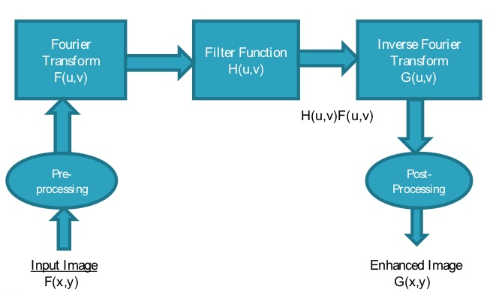
Methodology

Slide 4
Algorithm
1. Let original image f(x,y) of size M X N that is discrete image.
2. Apply zero padding to f(x,y) to get image fp(x,y) of size P X Q. such that P= 2M and Q= 2N if needed.
3. Multiply the padded image fp(x,y) by (-1)x+y to center the transform to u=P/2 And v=Q/2. Where u and v are center coordinate of padded image.
4. Compute the 2D- DFT of centered image f(u,v).
5. Define filter function h(x,y) of size P X Q get H(u,v) that is FFT of h(x,y)
6. Centralize the coordinate of H(u,v) at (P/2, Q/2).
7. Multiply F(u,v) by a filter function H(u,v).
8. Compute the inverse DFT of the result.
9. Crop the result in 6.
10. Obtain the real part of the result in 6.
11. Multiply the result in (6) by (-1)x+y to reverse centering of the output image as input image [1], [8].

Slide 5
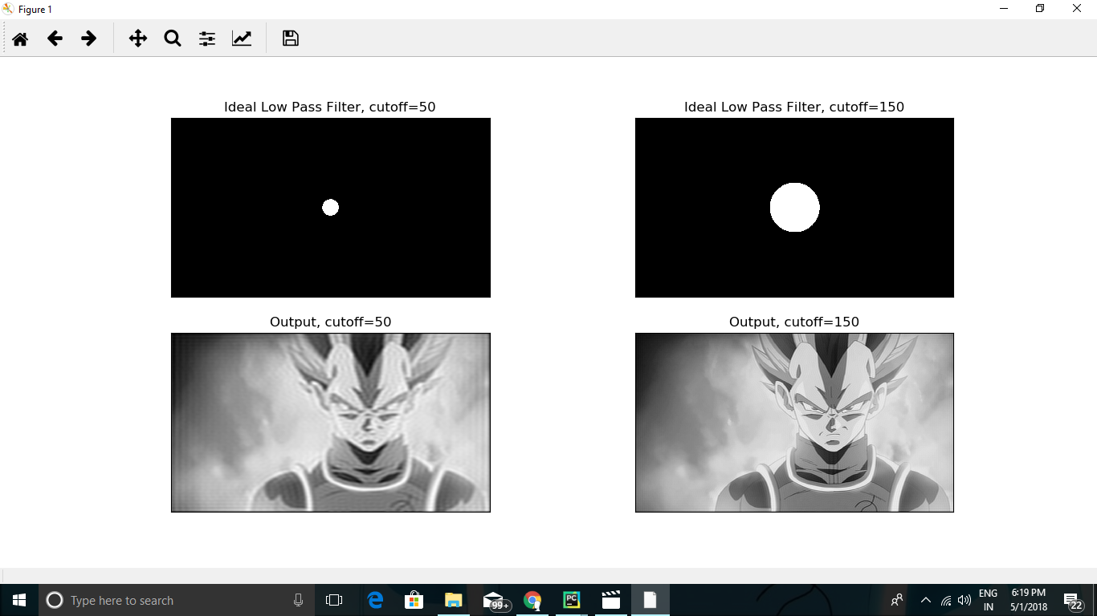
Ideal Low Pass Filter

Slide 6
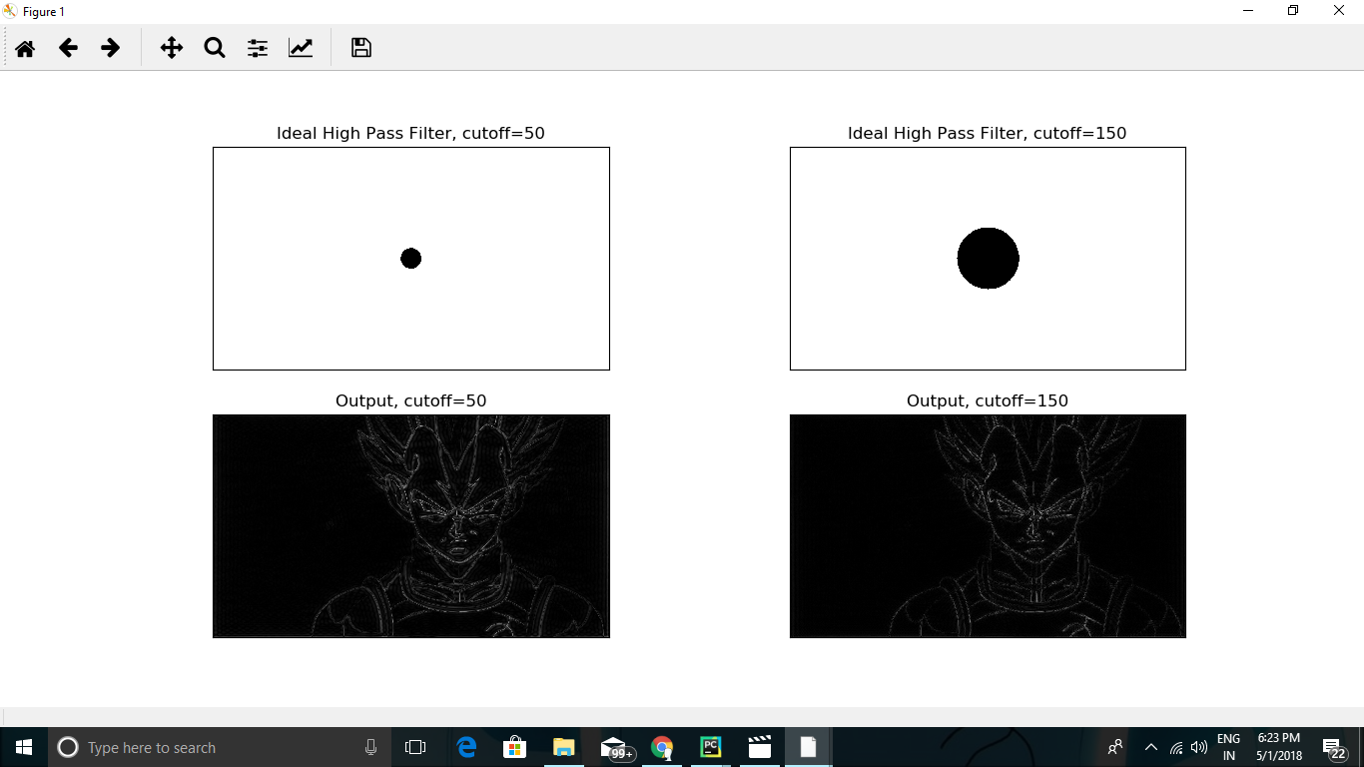
Ideal High Pass Filter

Slide 7
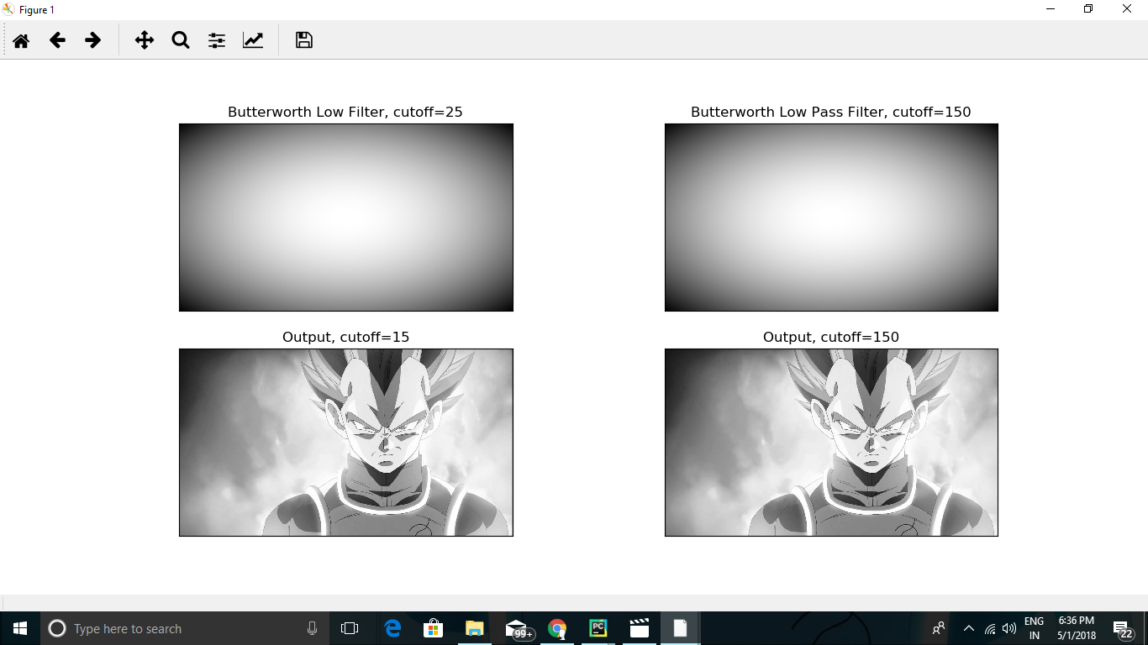
Butterworth Low Pass Filter

Slide 8
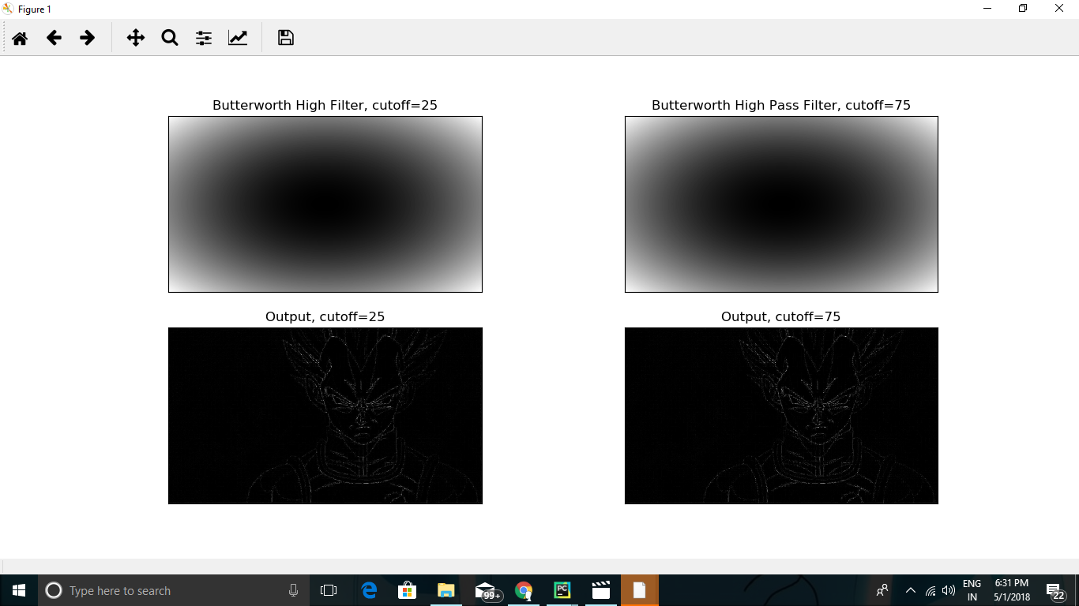
Butterworth High Pass Filter

Slide 9
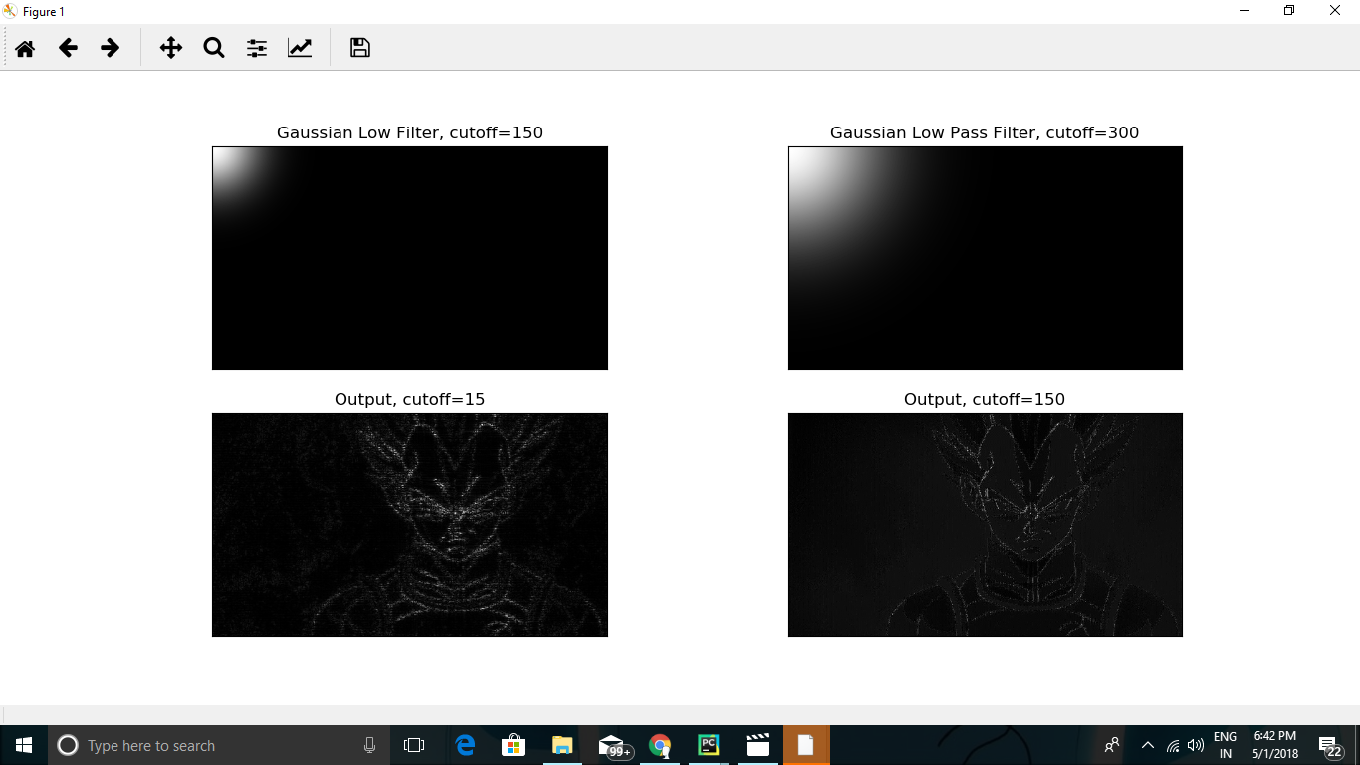
Gaussian Low Pass Filter

Slide 10
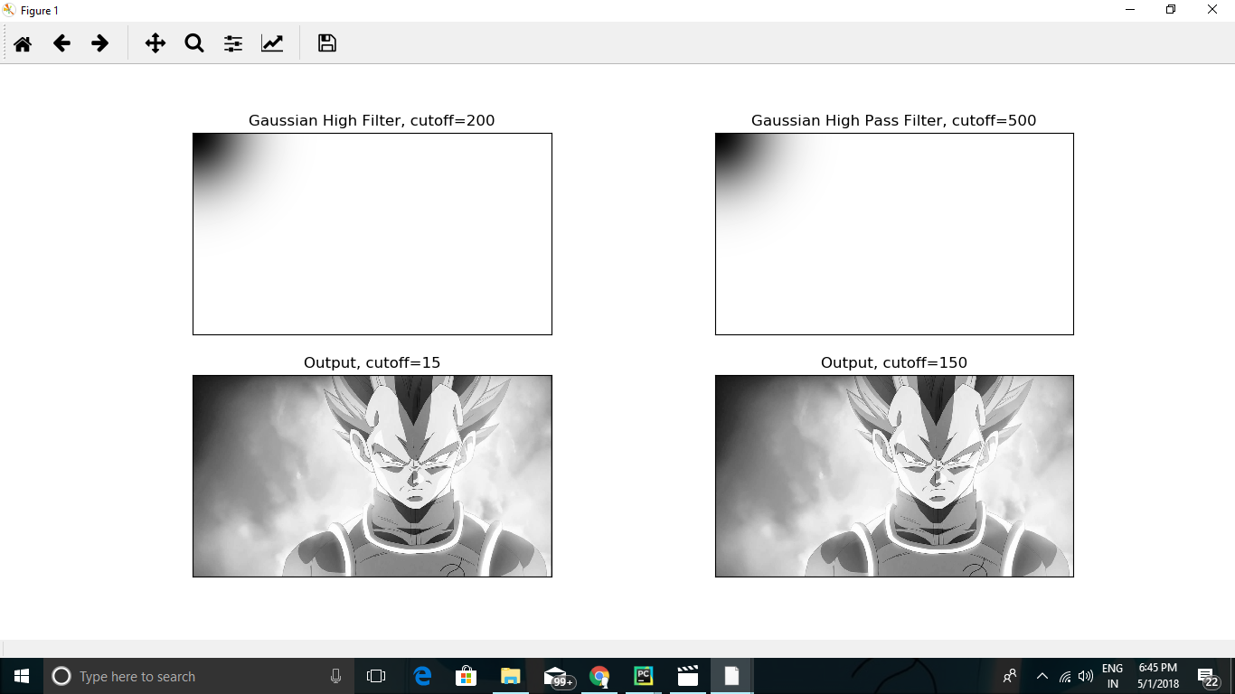
Gaussian High Pass Filter

Slide 11
Conclusion
Image enhancement is the prime aspect of digital image processing. Image filtering is an very important step in image enhancement. In this, we implement low pass and high pass filter for same cutoff frequency. We analyze the various results as shown, after successful simulation of all these filters. Their performance depends on selection of cutoff frequency.

Slide 12
Thank You

